Slide 1

How to unlock your potential:
Innovative & Sustainable Strategies for Goal Achievement

Slide 2
“It is always seems impossible until it’s done”
Nelson Rholihlahla Mandela

Slide 3
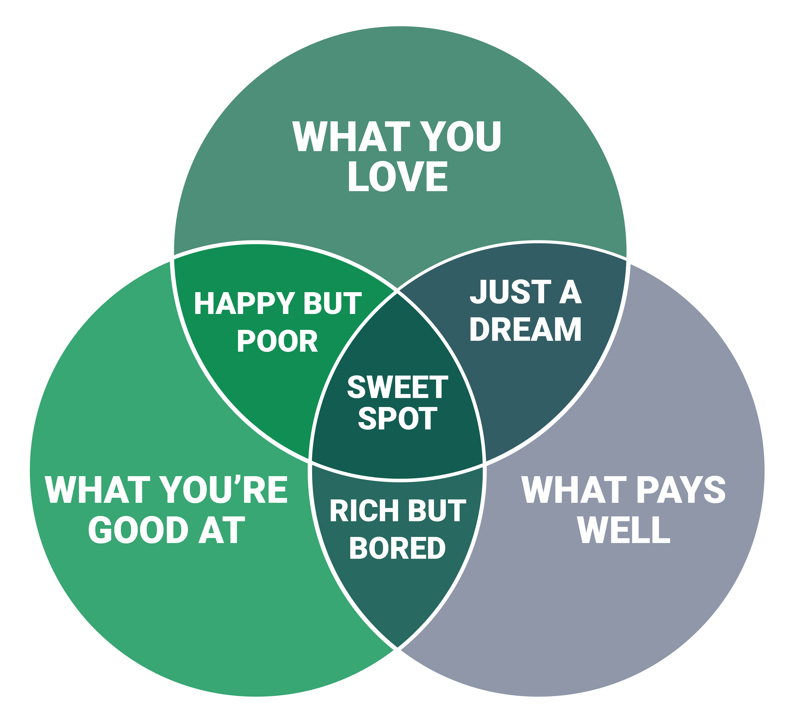

Slide 4
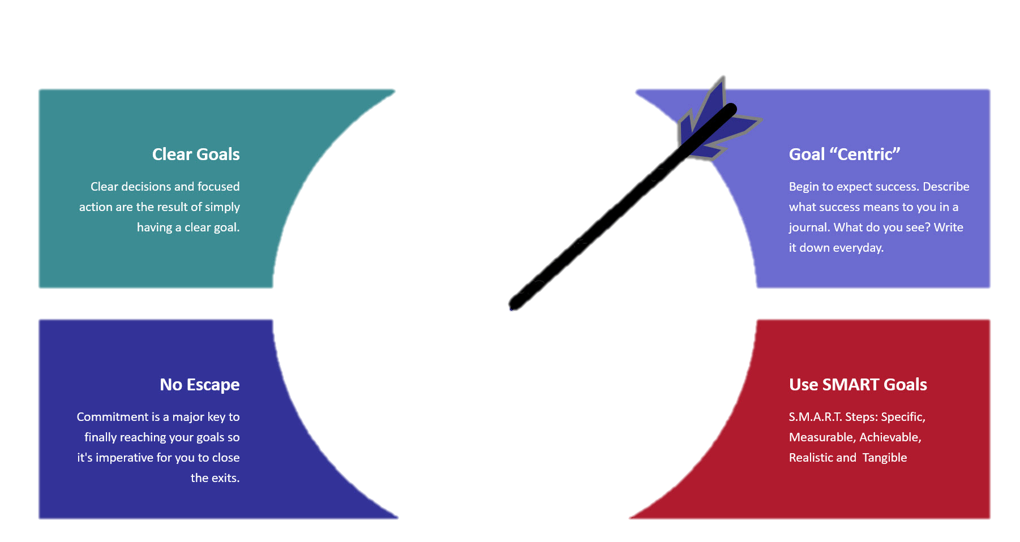
Use Goals To Your Advantage
What exactly are you trying to achieve
How will you know when you’ve achieved it?
Is it genuinely possible to achieve it?
Does it contribute to your agency’s revenue growth?
When do you want to achieve this by?

Slide 5



700 000 000 Housing Units
310 000 Schools
85 000 Health Centres
16 000 Housing Units
25 Schools
7 Health Centres
by 2050

Slide 6


APARA Global School Project
Situated in Twecu near King Williams Town
Eastern Cape, SA
186 Pupils
4 Teachers, 2 Assistants

Slide 7


APARA Global School Project
5 Volunteers
240 000 ZAR
12 Months
Stakeholder Management

Slide 8
HOW DO YOU UNLOCK?

Slide 9

Double Your Value, Double Your Income
1st: The 80/20 Rule:
  20% of tasks gives 80% of the value of all the things you do.
2nd: Identify activities in the 80%, downsize, delegate, and eliminate

Slide 10

See Yourself as Self-Employed
The president of your own company
An entrepreneur
A salesman of your own product
First identify the few things you can do that are more valuable and important than all the others

Slide 11

Whatever You Concentrate On Grows
Best minds in the world are committed to improving the psychological factors

Slide 12
Improvement Is Automatic
Next…
Identify the most vital actions and behaviours in each area, the ones that can bring you the greatest rewards and results in the shortest period of time

Slide 13

The law of Increasing Returns
The more focused you are on doing the few things that represent the most valuable use of your time.
The better you become at those activities and the less time it takes you to accomplish each one.

Slide 14
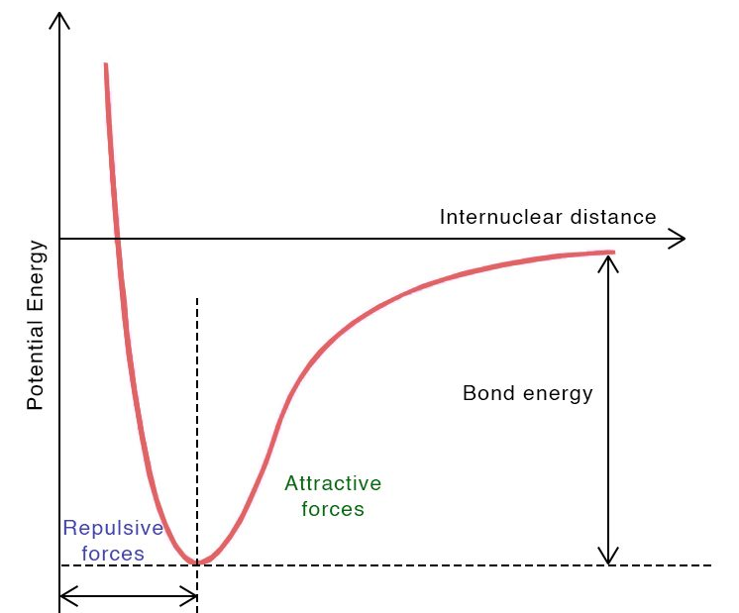
The Efficiency Curve
As you get better, you begin moving forward and downward along this curve, taking less time to get the same quality and quantity of results.

Slide 15
Your Habits Determine Your Destiny
Both learned and learnable
Automatic or conditioned
Good habits are hard to develop but easy to live with
Bad habits are easy to develop but hard to live with

Slide 16

The Grand SLAM Formula
Simplify
Leverage
Accelerate
Multiply

Slide 17

Simplify
You must be reducing and eliminating activities that take up too much time and contribute very littles to you goals, every day.

Slide 18

Leverage
Other People’s Knowledge
Other People’s Energy
Other People’s Money
Other People’s Successes
Other People’s Failures
Other People’s Ideas
Other People’s Contacts

Slide 19

Accelerate
Act quickly to satisfy the needs of other people
Looking for ways to do things faster for the key people

Slide 20
Multiply
Multiply yourself by working with other people who have skills and abilities that are complementary to your own

Slide 21
Multiply
Balance life challenges
Determine what your needs are spirituality and form family, work, body and mind

Slide 22


Double Your Time Off
Balance life challenges
Determine what your needs are spirituality and form family, work, body and mind

Slide 23
The Steps to Doubling Your Income and Doubling Your Time Off
Identify the few tasks that contribute the greatest value to your work
Identify the routine task and activities that consume so much time but contribute little to your long term goals. Then Delegate!
Used Grand Slam Formula
Have time to relax
Organised activities
Prioritised activities
Implement activities
Attention to the things you do and be aware of yourself and your actions. Make a good habits!

Slide 24

You Are Responsible
Accept responsibility
Form now on, no matter what happens, You will say to yourself “I am responsible!”
Have control over your life
Use your confidence and energy
High self-esteem, self-respect & pride brings direction to what you do

Slide 25
+
+
GRACE
TRUTH
TIME

Slide 26
THANK YOU

